Slide 1


Web Page Creation
Meghashree Maddihally Nagoji

Slide 2



TECHNOLOGIES USED

Slide 3
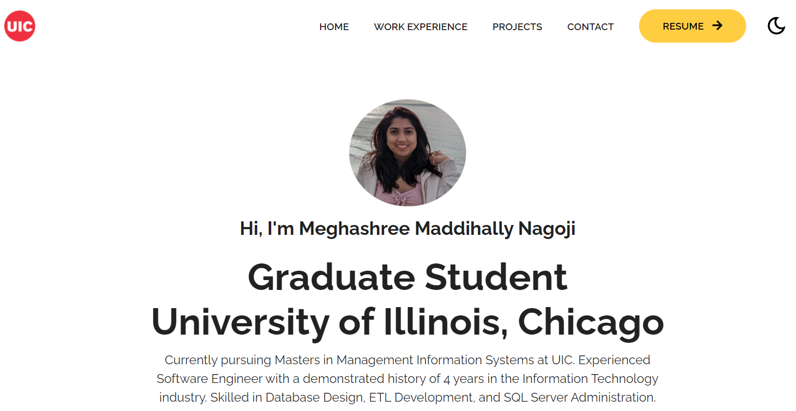
HOMEPAGE – Showing Navigation Bar and Introduction

Slide 4
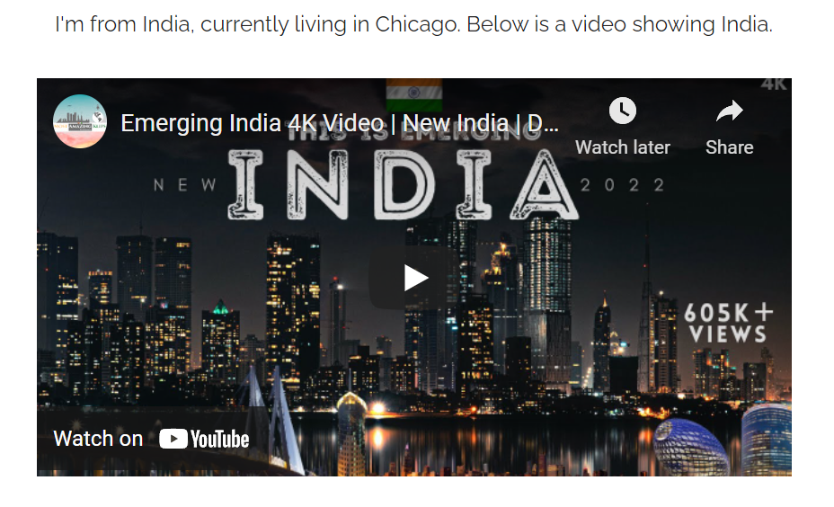
MULTIMEDIA IFRAME – Showing a video of my home country

Slide 5
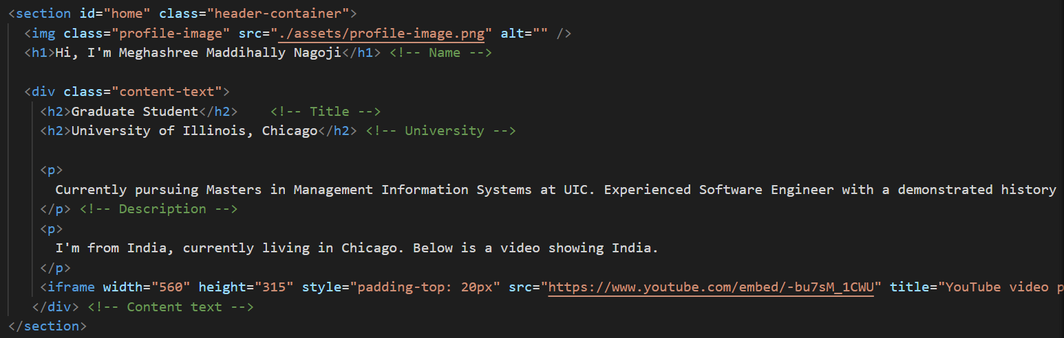
CODE – Introduction & Multimedia Video – HTML & CSS

Slide 6
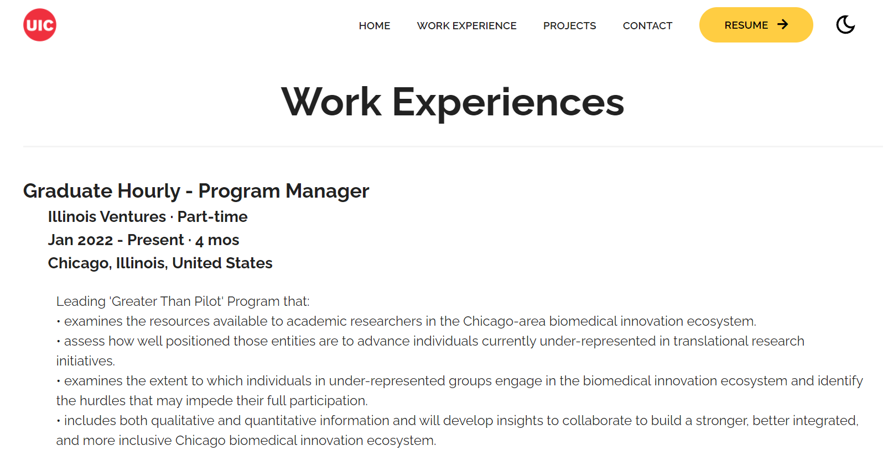
WORK EXPERIENCES – Showing all the Companies and Roles

Slide 7
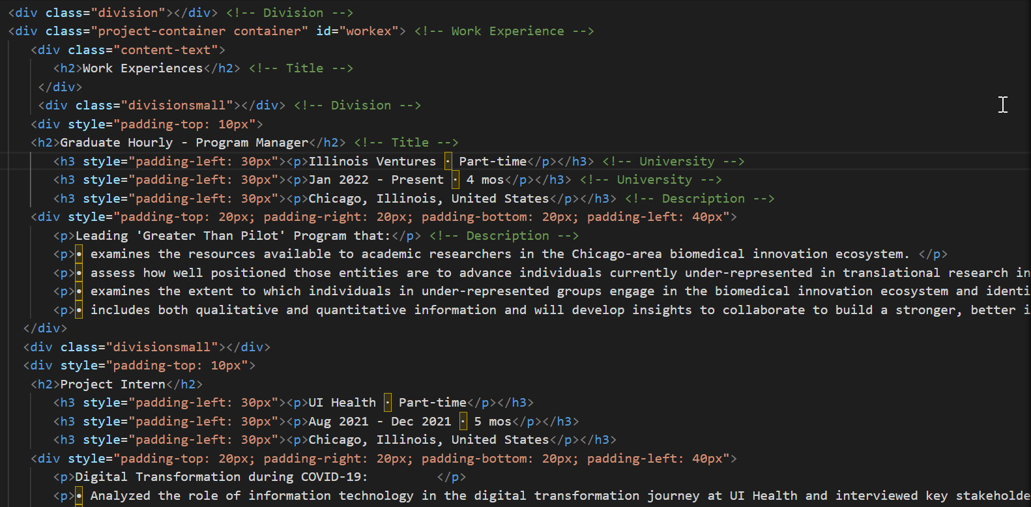
CODE – Work Experiences Widget – HTML & CSS

Slide 8

PROJECTS – Showing all the Projects worked on

Slide 9
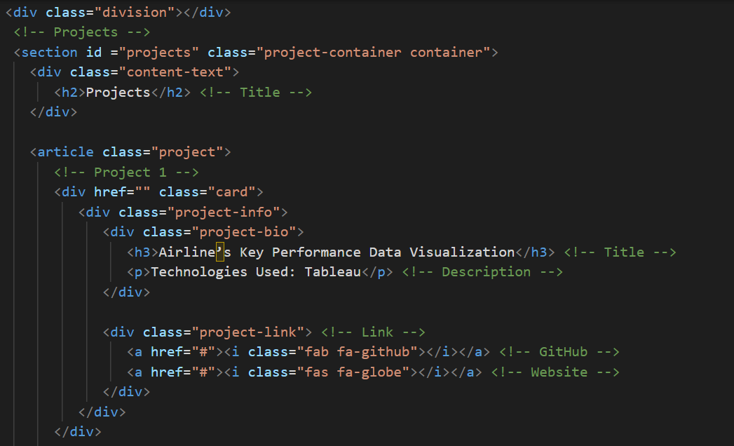
CODE – Projects Widget – HTML & CSS

Slide 10


CONTACT WIDGET
There are contact links for Facebook, Twitter, LinkedIn and GitHub
The icons highlight when we hover over it

Slide 11
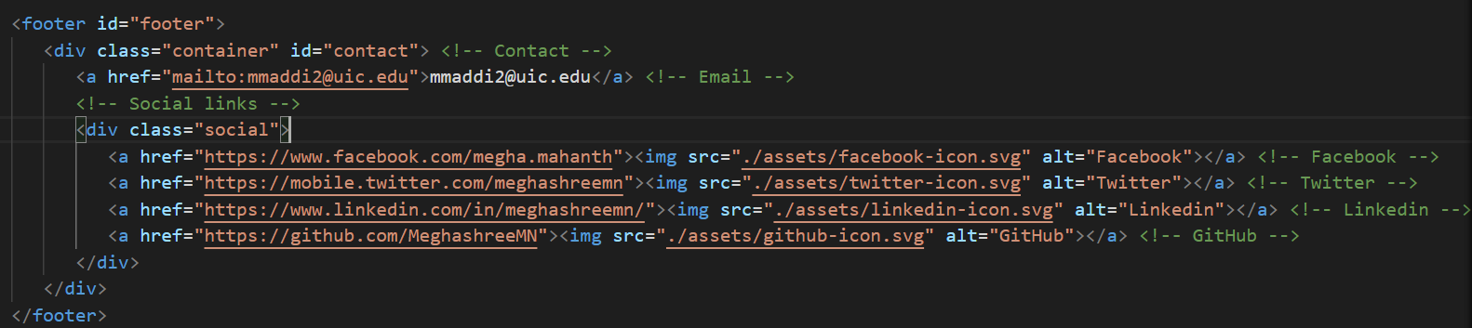
CODE – Footer – Contact Widget – HTML & CSS
Added links to various social media with respective icons
Icons highlight when we hover over it

Slide 12
NAVIGATION BAR
The Navigation Bar has Heading Names, which when clicked on Navigates to respective widget
On clicking RESUME button, resume will be opened
There is a theme changer, where we can toggle between Light and Dark Mode

Slide 13
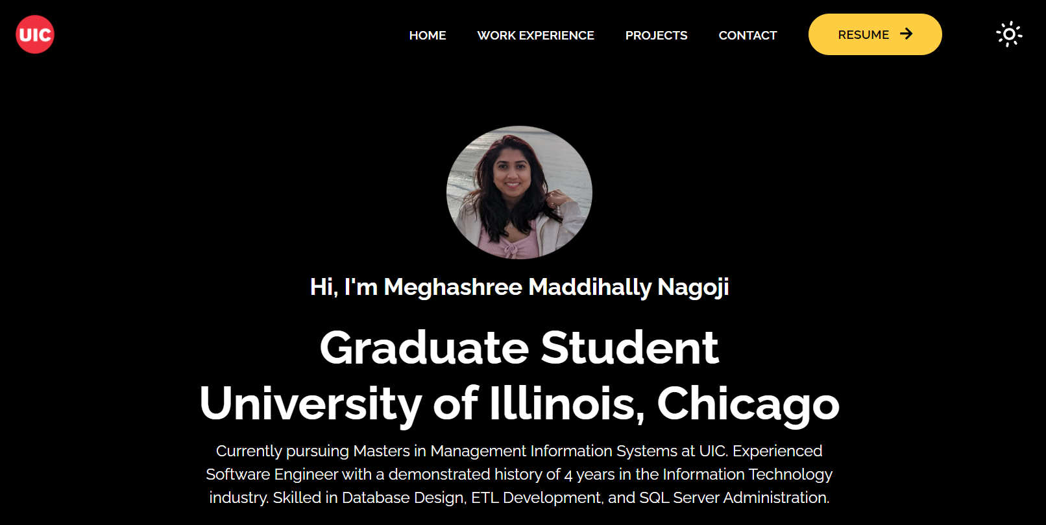
HOMEPAGE IN DARK MODE – After Clicking on Toggle Switch

Slide 14
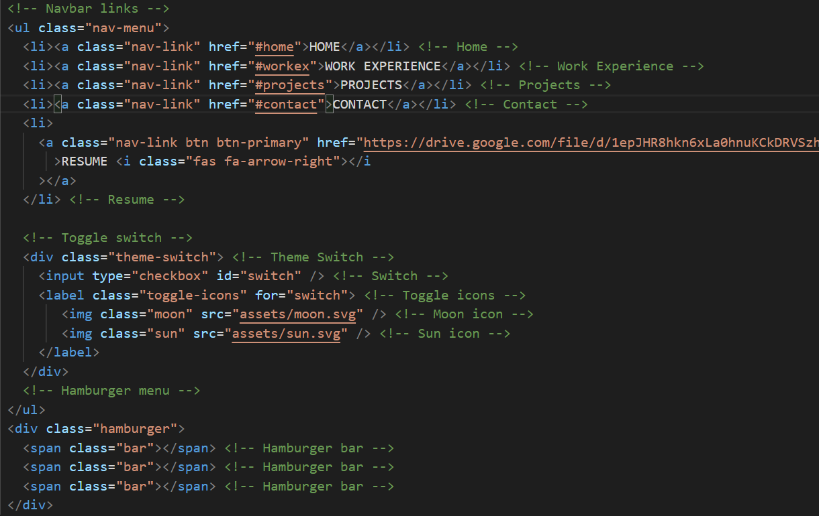
CODE – Navigation bar, Toggle Switch and Hamburger Menu – HTML & CSS

Slide 15
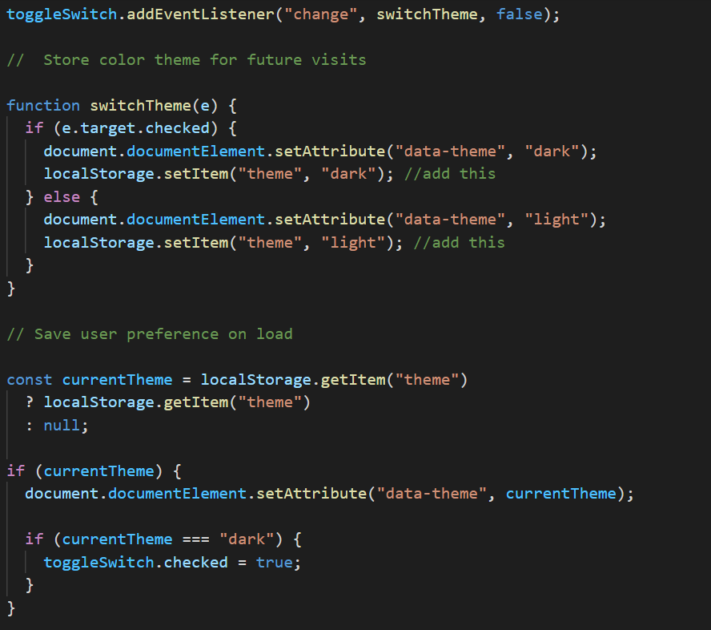
CODE - Theme Toggle – JavaScript

Slide 16
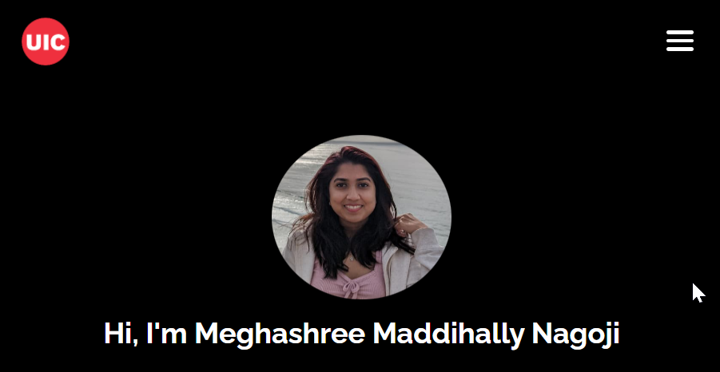
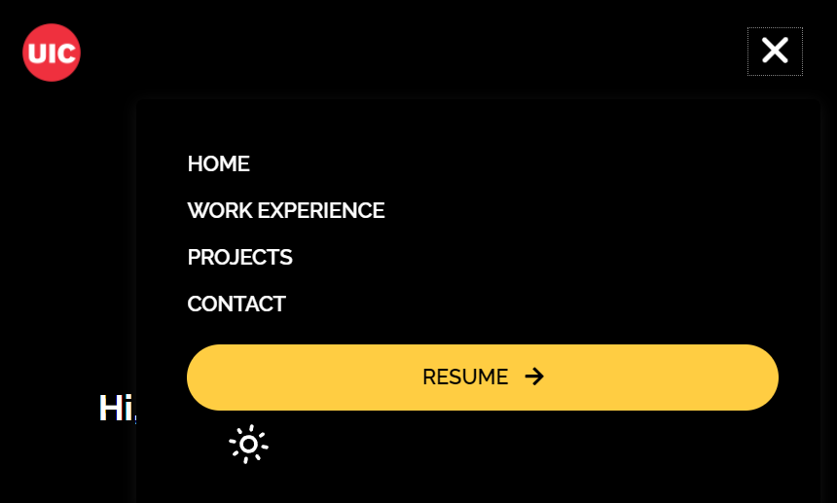
HAMBURGER MENU
When we resize the browser, the navigation bar gets converted into a Hamburger Menu
Also, the whole webpage is rescaled for that view

Slide 17
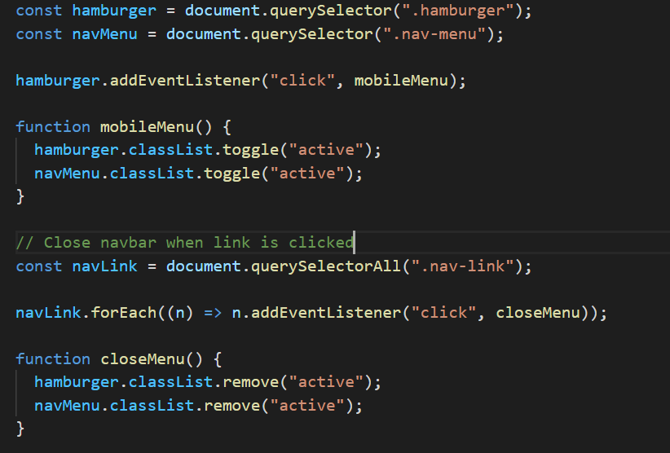
CODE - HAMBURGER MENU – JavaScript

Slide 18
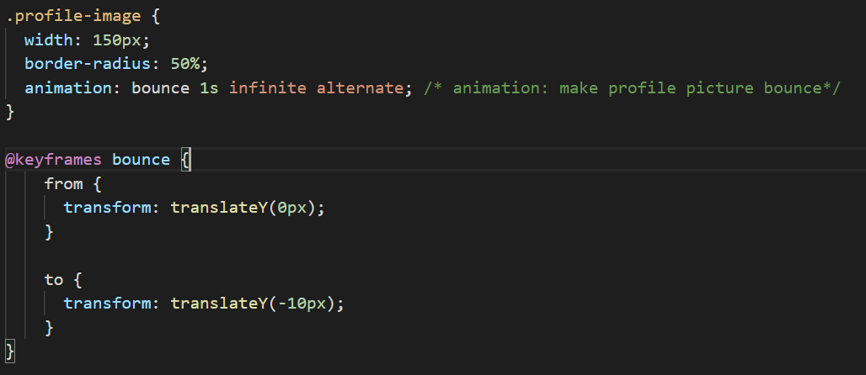
CODE - Profile Picture – Animation - CSS

Slide 19
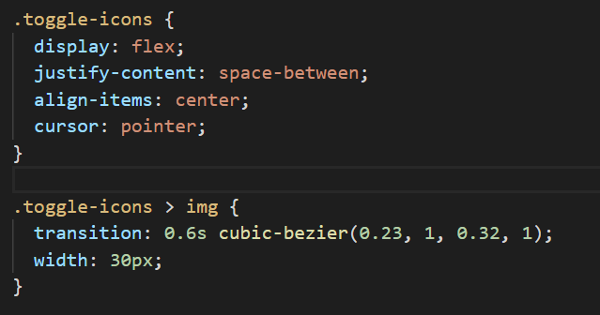

CODE – Icon Highlighter - CSS

Slide 20
IMPROVEMENTS
Improve interface and add more functionality
Implement animated and interactive background
Use a better UI/UX for Work Experience
Push code to GitHub
Host website on a domain

Slide 21


